Slide 1


Computer Vision and Robotics
Presenter: Vladislav Stoimenov, 235030
1

Slide 2
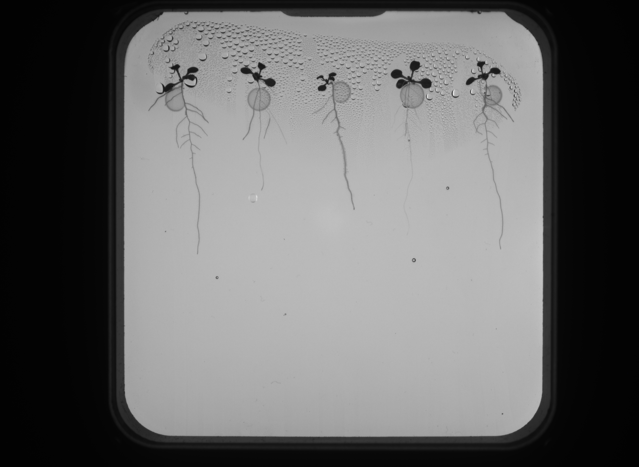
Problem Definition
‘Arabidopsis thaliana’ grown in Petri dish
Challenges
Challenge in automating the segmentation of plant roots from high-resolution images and controlling a liquid handling robot to inoculate plants in precise locations
Automate root segmentation and precision inoculation in the NPEC Hades system for efficient plant-microbe interaction studies.
2
Notes:
The Netherlands Plant Eco-phenotyping Centre (NPEC) is facing a challenge in automating the segmentation of plant roots from high-resolution images and controlling a liquid handling robot to inoculate plants in precise locations. Specifically, the Hades system produces daily morphometric images of Arabidopsis thaliana grown in Petri dishes, where roots crisscross over time, making it difficult to extract accurate quantitative data on root architectures and their interactions with microbial communities. Efficient and automated solutions are needed to overcome the manual bottleneck in image analysis and robotic control, enabling plant scientists to process large-scale datasets and perform precise inoculation experiments.

Slide 3
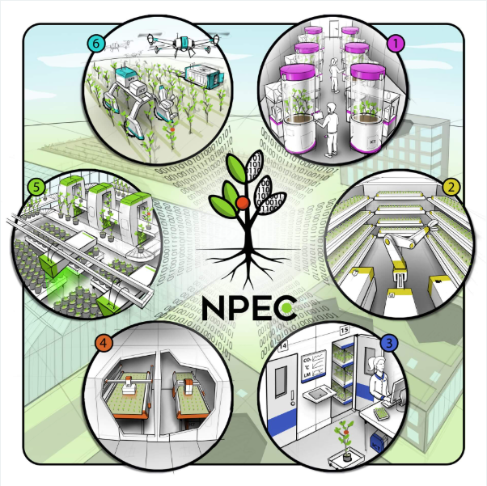
Overview
Netherlands Plant Eco-Phenotyping Centre
Implemented whole cv and robotics pipeline to inoculate the tip of the plants
Reduce time & costs
Automate the process of inoculating the plants
3

Slide 4
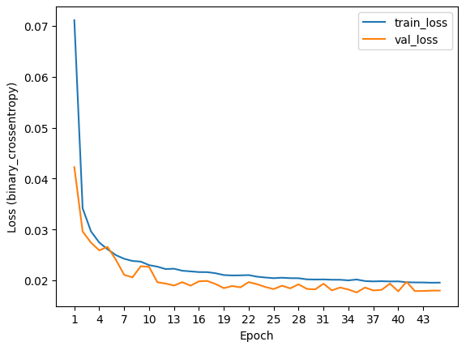
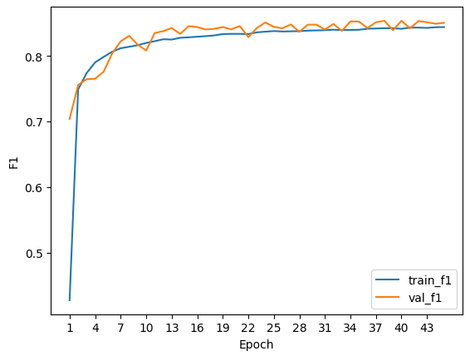
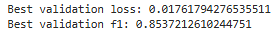
Results and Evaluation
Both Y23 and Y24 datasets
Patch_size = 256
Simple U-Net model
Model best val_f1 = 0.853
Model best val_loss = 0.0176
4

Slide 5
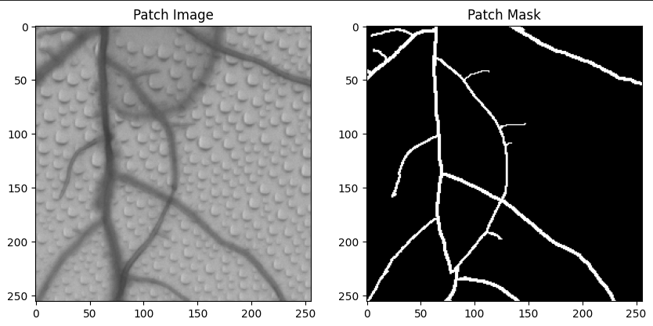
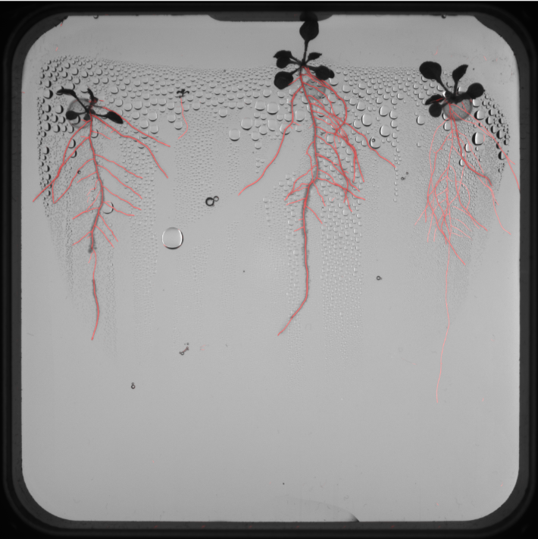
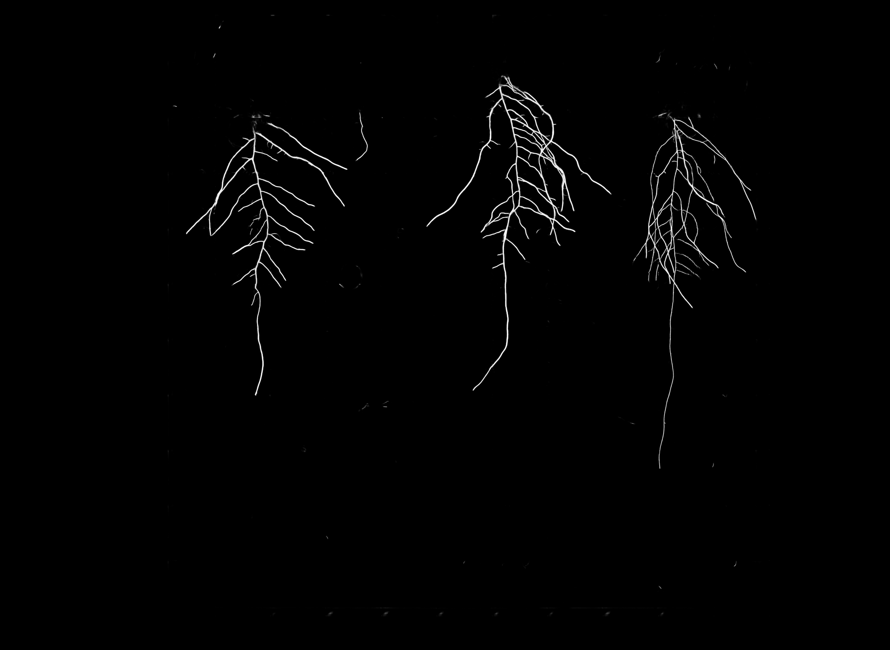
Results and Evaluation
Patch Image and Mask
Overlay of the Test Mask
Task 5 Test Mask
5

Slide 6
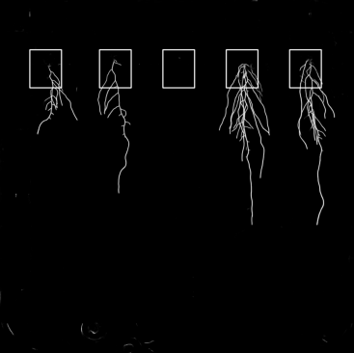
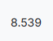
Best Iteration
Patching the Dataset
Filtering
Training
Inference
Individual Plant Segmentation
Main Root Extraction
Plant Segmentation Method
Private SMAPe Score:
6

Slide 7
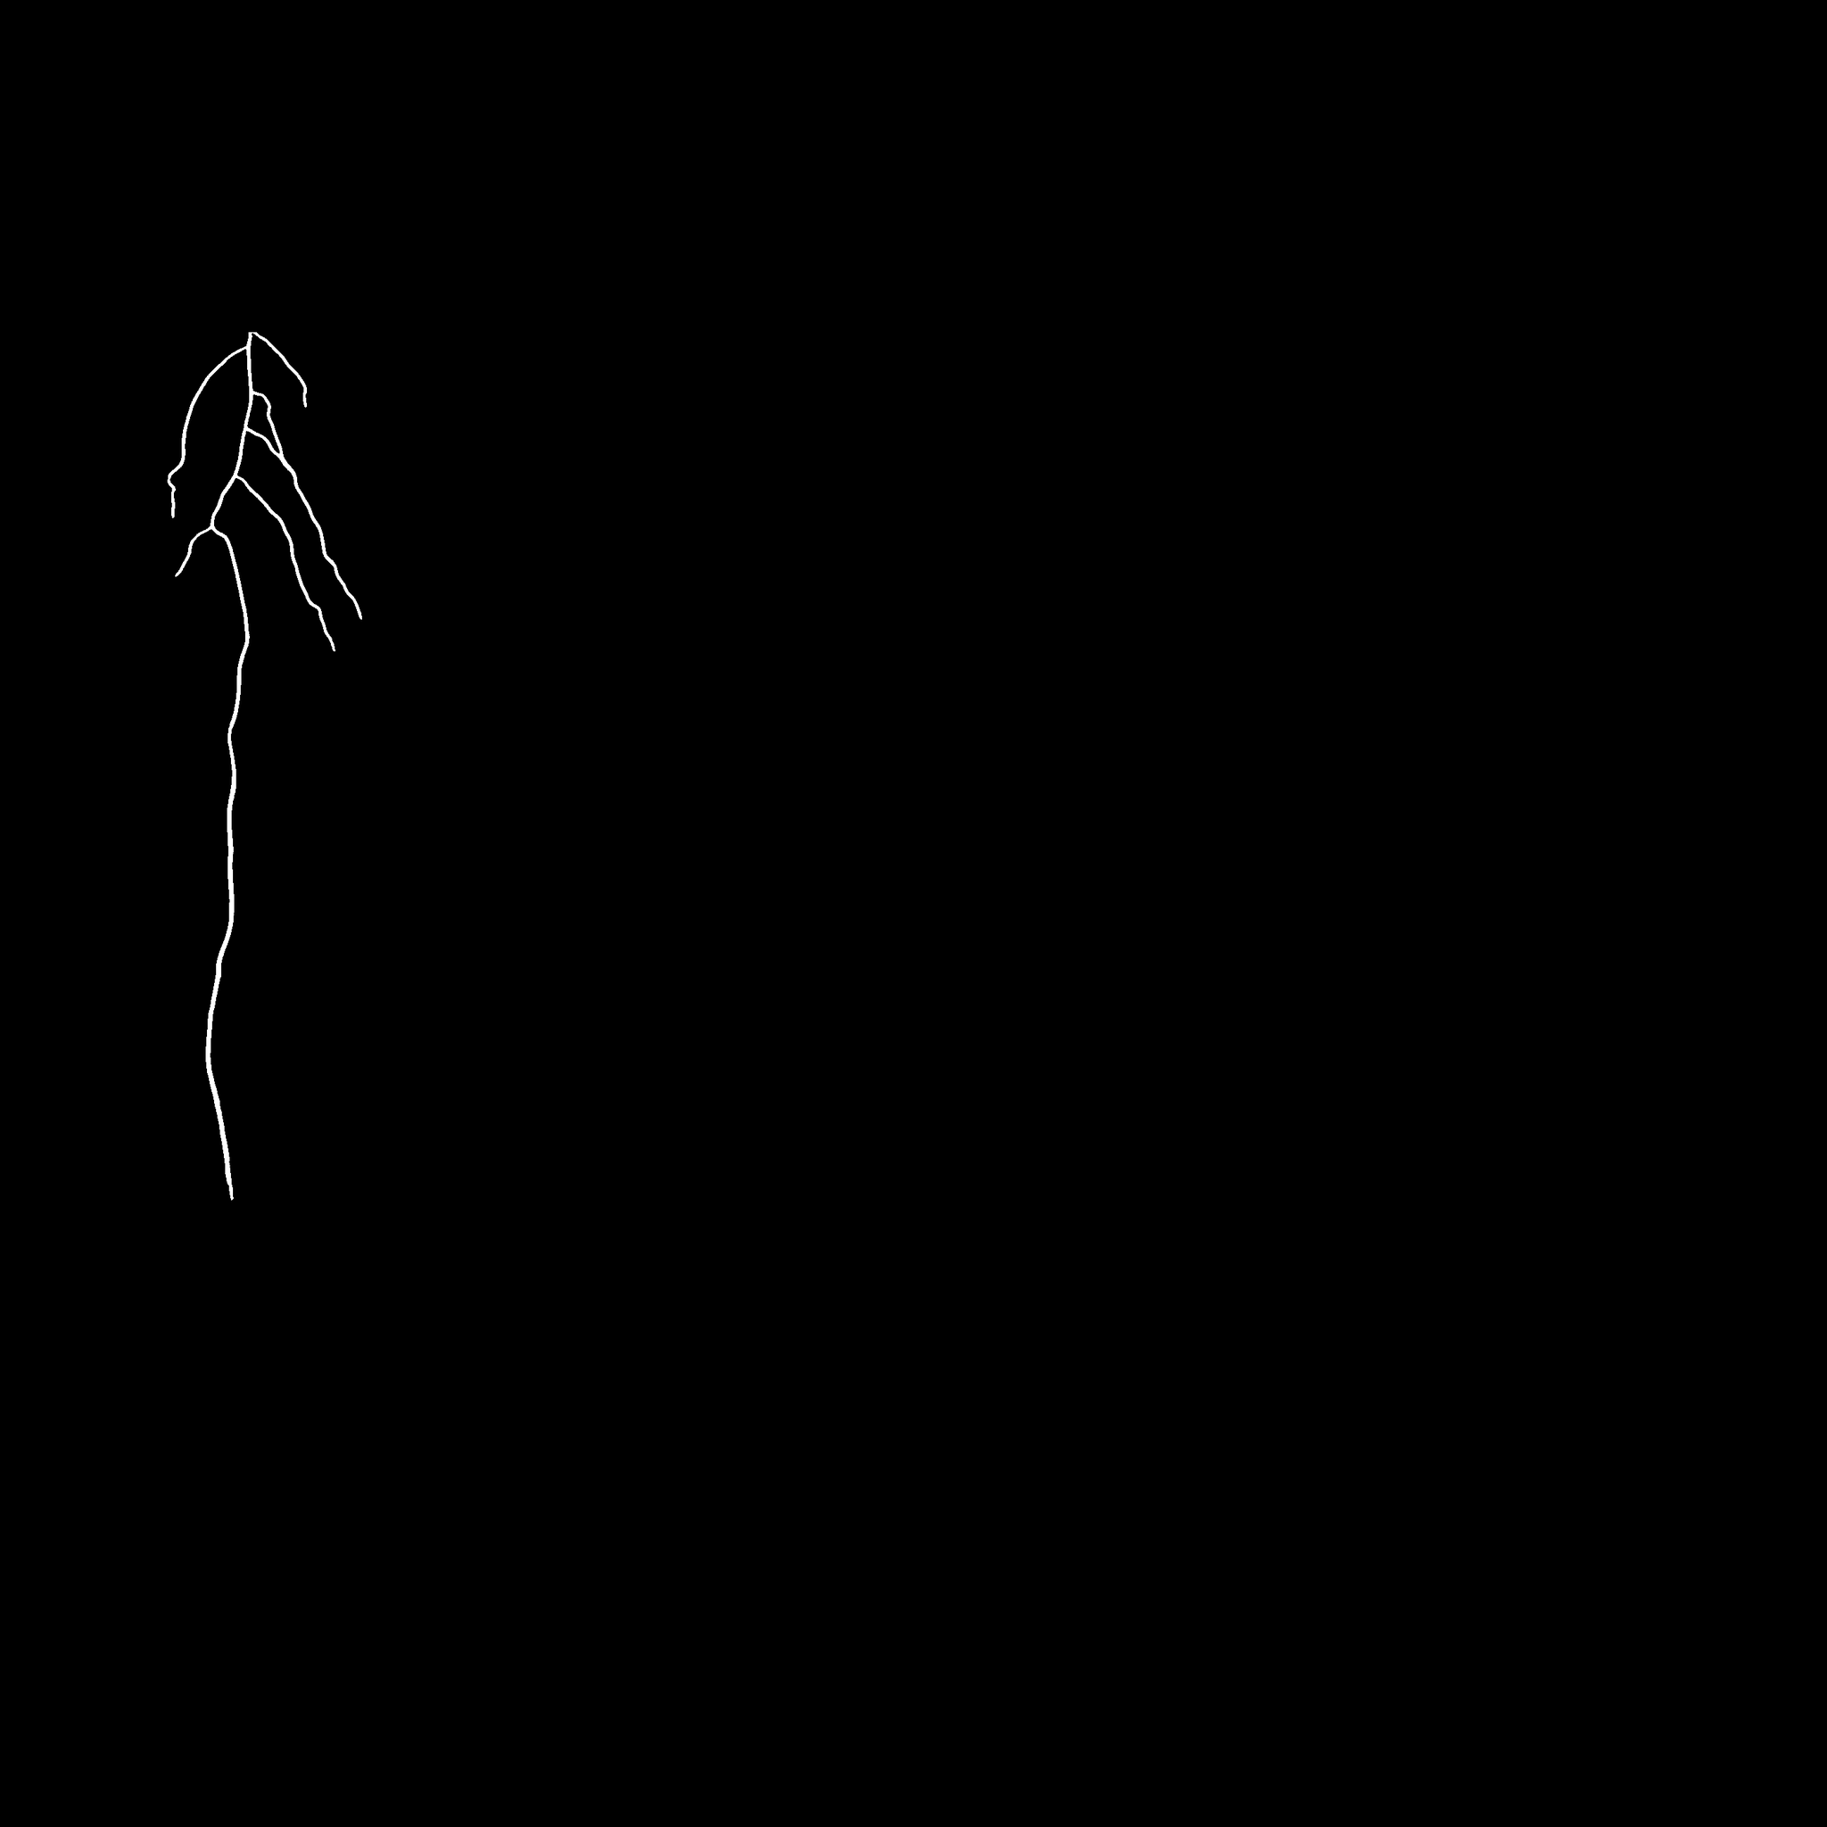
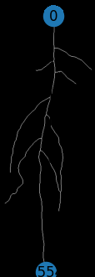
Best Iteration
Individual Plant Segmented
Main Root Length Measure
7

Slide 8
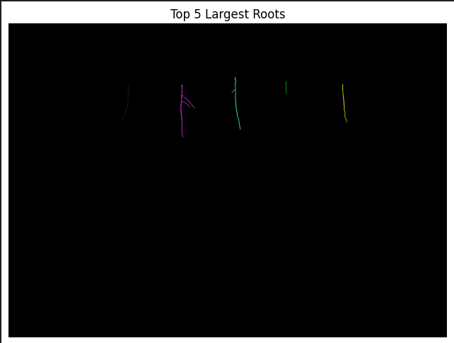
Error Analysis and Iteration
Removing masks containing only black pixels, leading to better model performance
Improve the segmentation of the individual plants
Measure the main root length by getting the distance between the first and the last node of the skeleton
8

Slide 9
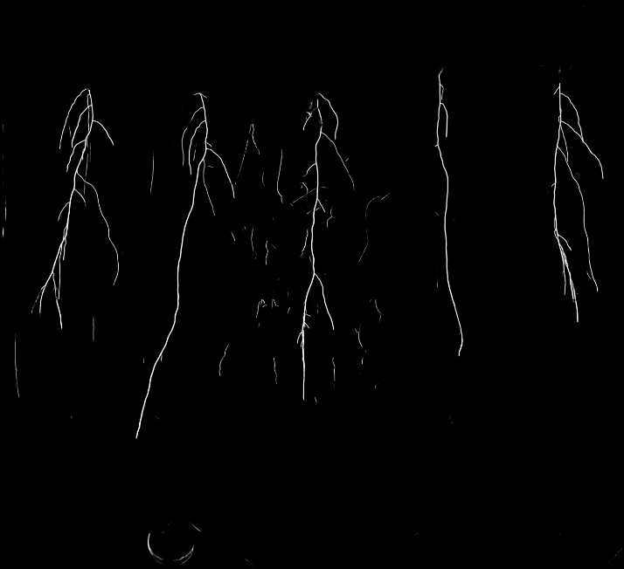
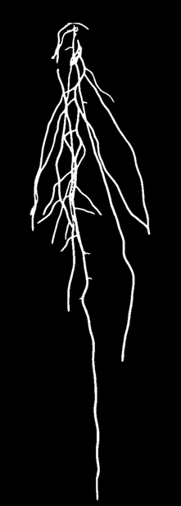
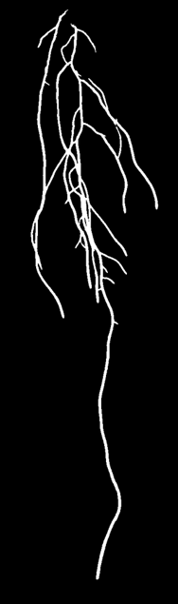
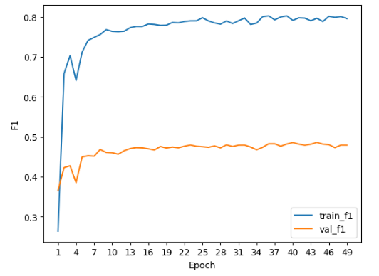
Image 18, Plant 4
Image 18, Plant 5
Iteration 1 (val_f1 = 0.48)
9

Slide 10
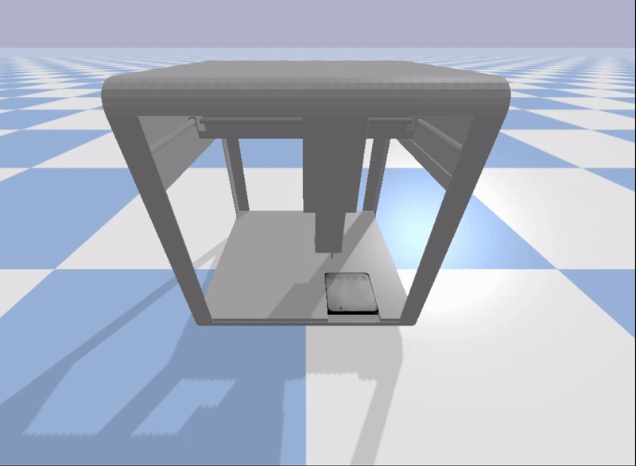
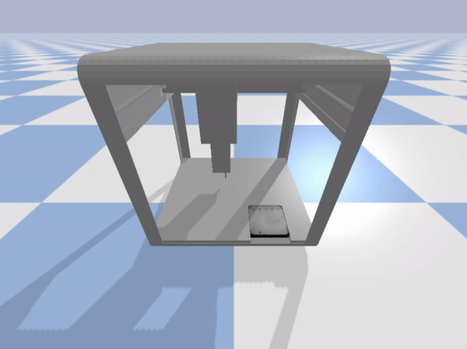
Reinforcement Learning
RL Implementation
3 models for different rollout steps – 2048, 4096, 8192
Threshold – 0.001m (1mm)
Moving the pipette to all 8 corners
Pipette Working Envelope:
X-axis : [-0.187; 0.253]
Y-axis : [-0.1705; 0.2199]
Z-axis : [0.1196; 0.2905]
10

Slide 11
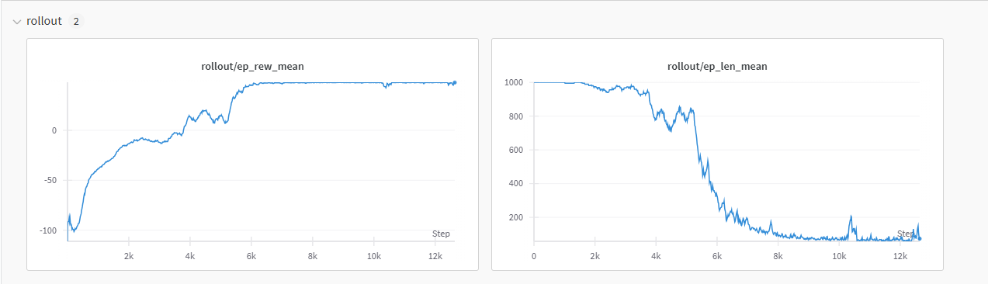
Model Performance
RL Implementation
Best model – 4096 Rollout Steps
Group best hyper parameters
Learning_rate = 0.0001;
Discount_factor=0.99;
Rollout_steps = 4096
11

Slide 12
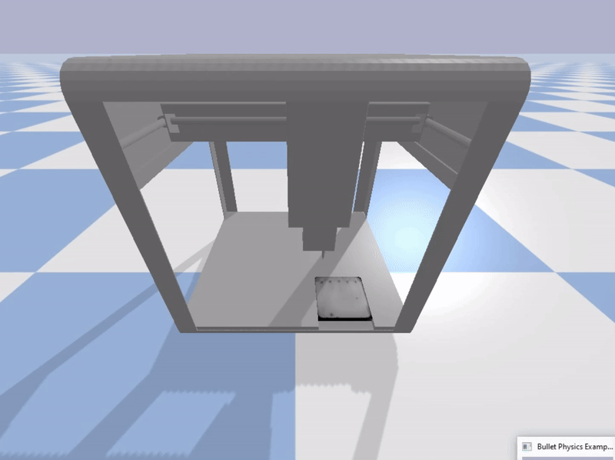
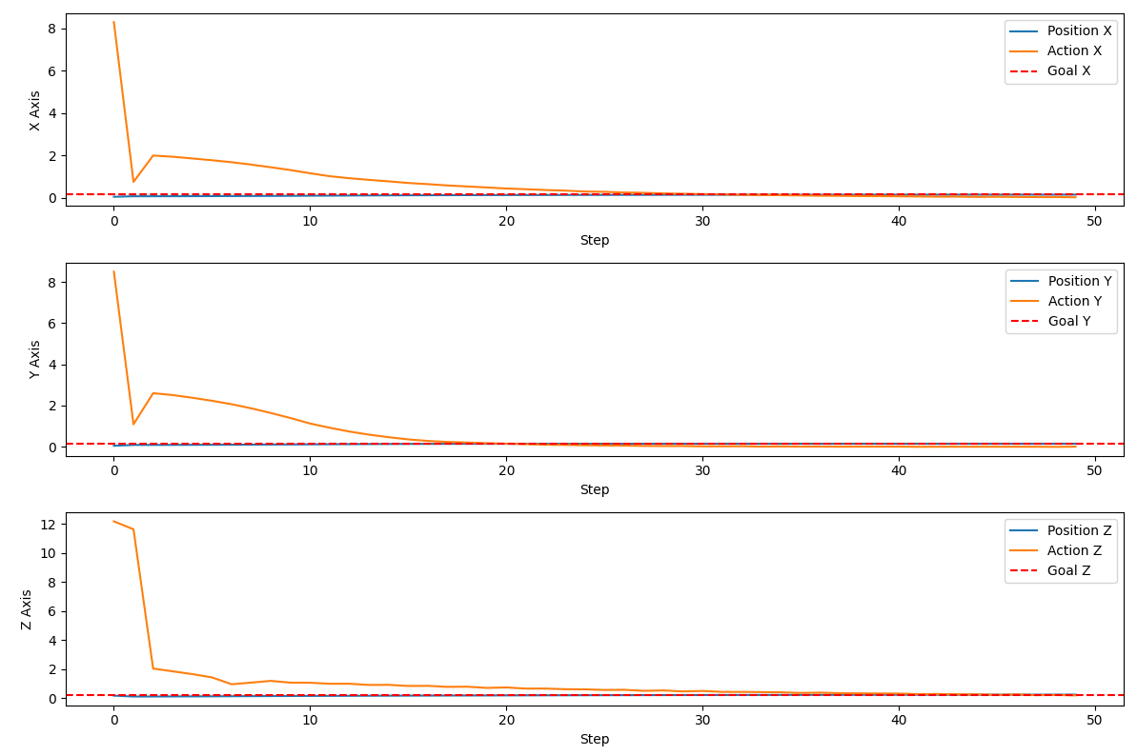
PID Controller
Implemented PID Controller
PID Gains for the x, y, z axes
X = 27, 0.5, 2.8
Y = 45, 0.1, 2
Z = 18, 2.8, 7.8
Overshooting the goal position
12

Slide 13
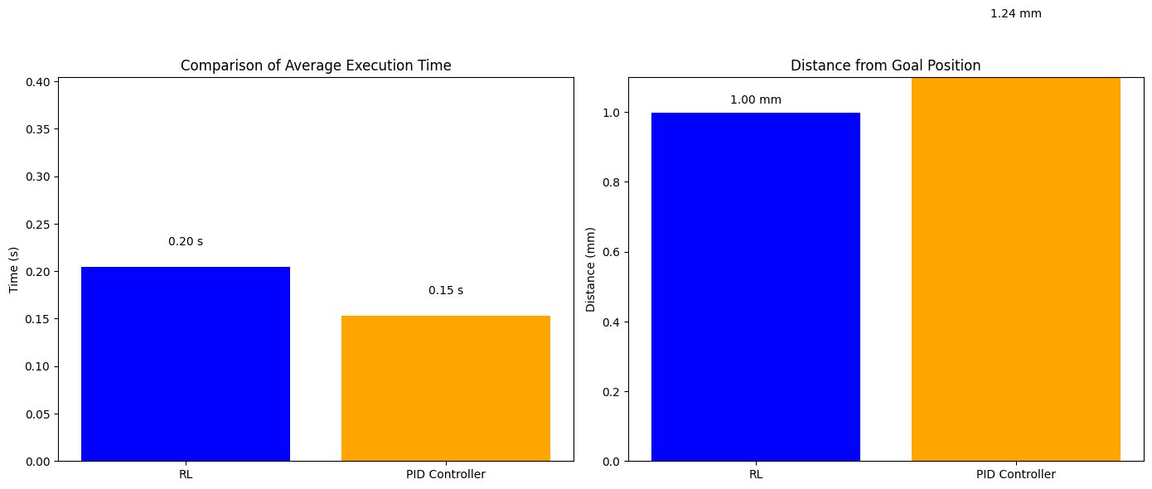
Benchmarking
Comparison between the average speed and distance to the goal position for both RL and Controller
Average speed: RL – 0.21, PID – 0.16
Average Distance From Goal Position: RL – 1mm, PID – 1.24mm
13

Slide 14
Next Steps for Improvement
Train better model and RL
Improve image pre-processing
Experiment with different strategies of measuring the main root length
Optimize the gains of the PID Controller
Combine all steps of the pipeline in one code
14

Slide 15
Thank you!
Presenter: Vladislav Stoimenov, 235030
15

